Slide 1
WebWatch
Under the Guidance of
Mrs. D. Sravanthi Assistant Professor,
Department of Data Science.
Presented By:
J. Prashanth
C. Omkar
S. Gouri Shankar
22R21A67F5
22R21A67E2
22R21A67J8

Slide 2

Abstract
WebWatch is an innovative Chrome extension designed to tackle the challenges of efficient time management and secure online exam supervision. Operating in two distinct modes - Normal Mode and Exam Mode - WebWatch caters to diverse user requirements. In Normal Mode, it empowers users to monitor their online activities, set customizable time limits, and receive pop-up alerts when these limits are exceeded. This promotes healthy browsing habits and ensures optimal time allocation across online activities. In Exam Mode, WebWatch enforces strict measures to prevent cheating, such as full-screen mode enforcement, tab closure upon exit, and examiner-set password activation. These features create a controlled and secure online examination environment, upholding academic integrity. WebWatch stands out as a valuable tool for individuals and educational institutions, offering a practical approach to managing online activities and ensuring academic integrity.

Slide 3
Objectives
Develop a Dual-Mode Chrome Extension
To provide integrated solutions for digital productivity and online examination security.
Empower Users & Ensure Integrity
Enable effective time management in Normal Mode and enforce a secure environment for exams.
Prioritize User Experience & Privacy
Deliver an intuitive, reliable, and privacy-conscious solution operating entirely client-side.

Slide 4
Literature Survey
S. No. | System Name / Category | Method / Approach | Advantages | Disadvantages
1 | StayFocusd | Chrome Extension: Website blocking, time limits. | Free, customizable, client-side. | Browser-specific, bypassable, no proctoring.
2 | RescueTime | Cross-platform: Automatic time tracking, reports. | Automatic, detailed insights, cross-device. | Freemium, intrusive, not a blocker.
3 | Respondus LockDown Browser | Dedicated secure browser: Restricts access. | High exam security, widely adopted, prevents cheating. | Requires installation, clunky, no time management.
4 | ProctorU / Examity | Remote Human/AI Proctoring: Monitoring, verification. | Highest security, human oversight, identity verification. | Expensive, privacy concerns, scheduling needed, no time management.
5 | Forest / Pomodoro Apps | Timer-based: Gamification, focused sessions. | Simple, promotes focus, cross-platform, gamified. | Primarily a timer, no blocking/proctoring, relies on discipline.

Slide 5
Proposed System
WebWatch Chrome Extension: A client-side, privacy-focused browser tool.
Dual-Mode Operation: Adapts to user needs (Normal vs. Exam Mode).
Local Data Storage: All data is processed and stored within the browser, ensuring privacy.
Light-weight & Reliable: No external servers needed.
Real-time website usage tracking.
Password-protected activation/deactivation.
Customizable time limits for distracting sites.
Full-screen mode enforcement.
Normal Mode (Productivity)
Exam Mode
(Security)
Proactive pop-up alerts.
Automatic closure of unauthorized tabs/windows.
Usage history dashboard.
Restricted navigation to exam URLs.

Slide 6
Architecture / Modules
The WebWatch Chrome Extension utilizes a client-side, modular architecture for efficiency and privacy. It consists of several interconnected components:
Background Script
The central intelligence, handling all browser events, time tracking, mode management, and communication.
Popup UI
Provides quick user interaction, real-time data display, and access to settings.
Options Page
Offers comprehensive configuration for time limits, Exam Mode, and historical data viewing.
Specialized Managers (Internal)
Modules like Time Tracker, Time Limit Manager, and Exam Mode Manager encapsulate specific logic for their respective functions.
Chrome Storage
Handles all secure, local data persistence within the browser.

Slide 7
UML Diagrams (Module wise)

Slide 8
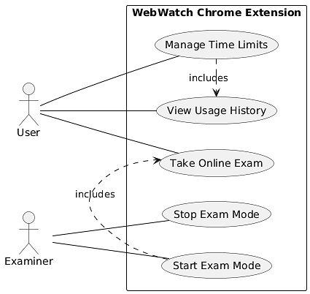
Use case Diagram

Slide 9
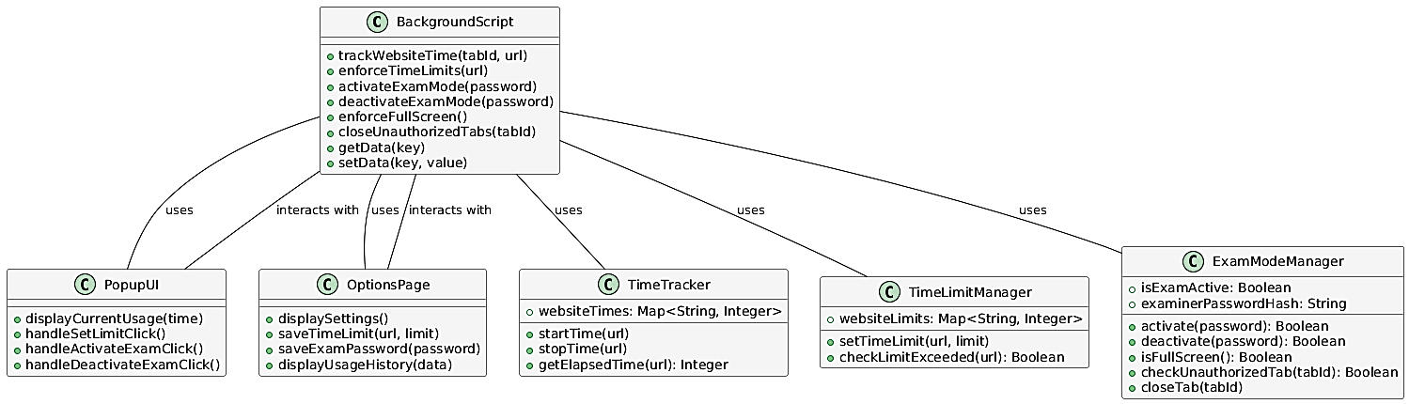
Class Diagram

Slide 10
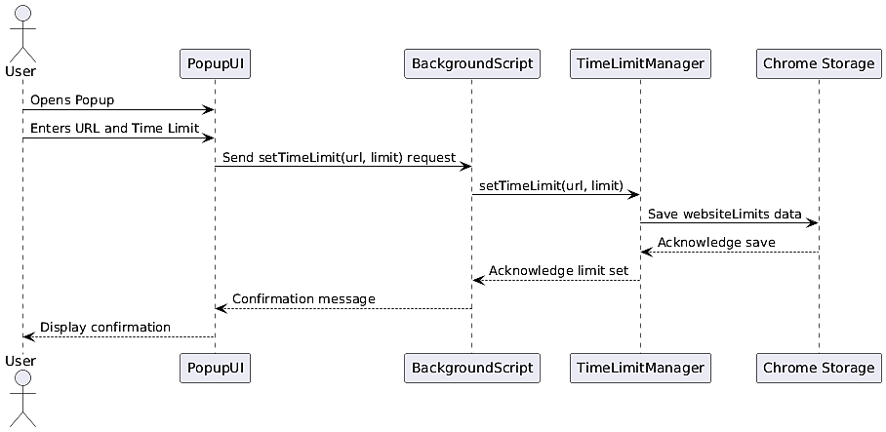
Sequence Diagram

Slide 11
Methodologies/Algorithm/Technologies
The project utilizes an Agile and Iterative development approach, emphasizing user-centred design and flexible adaptation to requirements.
WebWatch employs precise logic for time tracking (monitoring active tabs), limit enforcement (comparing usage to set limits), mode switching (managing Normal vs. Exam state with secure password hashing), and Exam Mode controls (monitoring full-screen, closing unauthorized tabs via URL pattern matching).
The extension is built using standard JavaScript, HTML5, and CSS3. It relies heavily on the Google Chrome Extension API (Manifest V3) for browser interaction and uses chrome.storage.local for all secure, client-side data persistence.

Slide 12
Results
Normal Mode
Provides real-time website usage display, pop-up alerts for time limits, and historical data summaries, enhancing user productivity.
Exam Mode
Creates a secure Browse environment by enforcing full-screen, automatically closing unauthorized tabs, and preventing academic dishonesty.
Ensures user settings and data are persisted locally, contributing to a streamlined and controlled online experience.

Slide 13
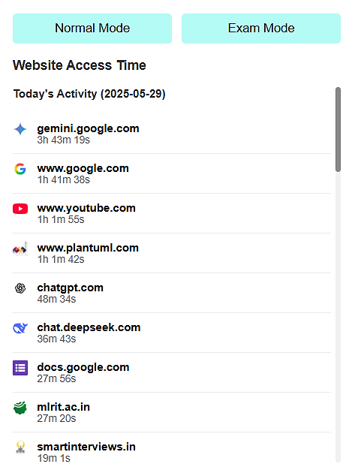
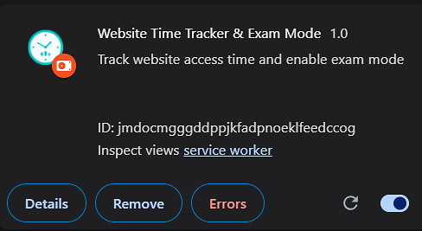
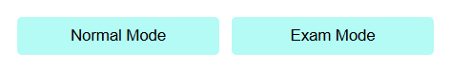
Output Images

Slide 14
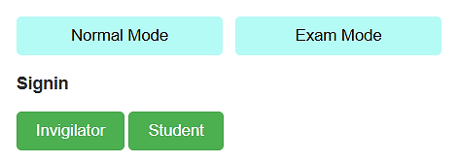
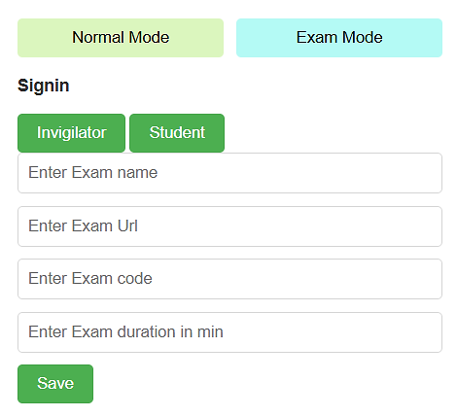
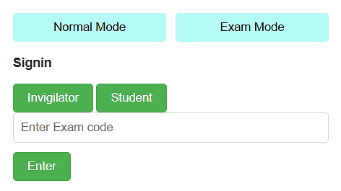
Output Images

Slide 15
Conclusion and
Future Enhancements
Integrated Solution - WebWatch effectively addresses both digital distraction management and online exam integrity within a single Chrome Extension.
Privacy-First Design - Operates entirely client-side, ensuring user data privacy and minimizing external dependencies.
Empowers Users - Enhances productivity through time limits and alerts, while providing a secure, non-intrusive environment for online assessments.
Versatile & Accessible - A user-friendly, lightweight, and cost-effective alternative to complex or intrusive existing solutions.
Continuous Evolution - Future enhancements aim to introduce advanced time management, enhanced exam security, improved UX, and potential integrations, solidifying its role as a comprehensive digital tool.

Slide 16
Thankyou

